Slide 1
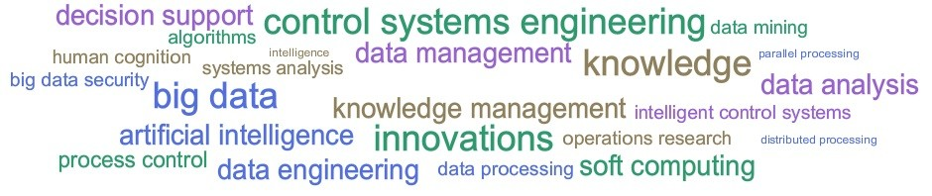
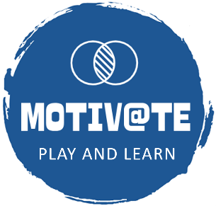


Evaluation of Video Games for STEM Education
• Valentina Terzieva¹ • Boyan Bontchev²
• Yavor Dankov² • Aleksandar Dimov²
¹Institute of Information and Communication Technologies
Bulgarian Academy of Sciences
²Faculty of Mathematics and Informatics,
Sofia University “St. Kliment Ohridski”, Bulgaria
9th IEEE “Big Data, Knowledge and Control Systems Engineering” Conference BdKCSE’2025
06–07 November 2025, Bankya, Bulgaria

Slide 2
INTRODUCTION
Educational video games (EVGs)
employ successful game-based learning practices, modifying traditional teaching methods for young learners
motivate students to adopt new knowledge and skills
offer opportunity to apply various methods of content customization and adaptation to meet learners’ needs and achieve the goals set by the educators
Science, Technology, Engineering, Mathematics (STEM) education
promote the development of foundational competencies and transversal skills
provide students with the knowledge needed to meet the demands of the 21st century
Study goal
to assess the use of video games in STEM education and the methods for evaluating them, focusing on the last decade

Slide 3
Educational video games in STEM education
Learning with games is recognized as an effective and practical approach to gain students’ interest in STEM education
Characteristics of STEM education:
Possibility to conduct experiments on real-world scenarios and applications
Incorporation of contemporary technologies and tools
STEM focuses on the development of skills related to:
Problem-solving
Critical thinking
Data analysis
Quantitative reasoning skills
Applications in interdisciplinary education

Slide 4
Popular genres of educational video games in STEM education 1/2
Simulation games – create realistic environments that represent real-world phenomena and allow players to manipulate variables in these phenomena to observe outcomes.
can recreate various STEM environments in a risk-free manner to explore complex topics in engineering, physics, etc.
allow development of problem-solving and critical thinking skills, the augmentation of experimentation capabilities of learners
Puzzle and logic games – these games require players to solve a specific kind of problem that increases their pattern recognition, logical reasoning, and strategic thinking skills.
allow effective teaching mathematical concepts, coding, algorithms, etc.
Role-playing games (RPGs) – players take the roles of particular characters and make decisions in an imaginary scenario.
typically combine elements of storytelling, problem-solving, and exploration to engage students in scientific quests, exploration, or engineering through interactive learning
.

Slide 5
Popular genres of educational video games in STEM education 2/2
Strategy games – these games requires players to plan, optimize solutions, manage resources, and adapt to changes in order to meet a set of rules or constraints.
In STEM they are used in teaching concepts such as engineering and economics
Quiz games – in these games players are encouraged to recall information according to the topic of the questions in a quiz. They are most straightforward in science and mathematical education.
Strategy and quiz games are applicable when tutors want to encourage competition between students.
Virtual/ Augmented Reality games – VR and AR technologies provide interactive environments where students can engage with STEM concepts in various ways.
- provide opportunities for virtual laboratory experiments (chemistry, physics, biology), explore human anatomy, simulate space missions,…

Slide 6
Game qualities and metrics - Validations
Validation of video games for learning and educational purposes involves examining:
Game qualities – e.g., design and learning experience
Learning metrics – e.g., educational outcomes:
Whether the game effectively supports the learning objectives stated by teachers and educators
Knowledge gains – assessed through pre- and post-tests (before and after gameplay)
Knowledge retention over time – assessed through delayed post-tests.
Skills and competencies obtained through game-based learning (procedural fluency, decision-making, and problem-solving)
Validations are conducted as:
Short-term (i.e., single session, day, or week) studies
Longitudinal studies (i.e., month, semester, or year) studies

Slide 7
Game qualities and metrics – Assessment
Assessment of educational video games concerns:
Determining how usable, engaging, and appropriate it is for specific learning goals. Usability involves assessments of the following aspects:
Playability – various facets of the player experience achieved while playing a game system, regarding the extent to which it feels enjoyable and entertaining. Focus on six core aspects of playability:
Learnability
Efficiency
Satisfaction
Accessibility
Error handling
Intrinsic
Mechanical
Interactive
Artistic
Intrapersonal
Interpersonal (social)

Slide 8
METHODOLOGY 1/2
Goal: to examine the characteristics of the most commonly used educational games in the teaching of STEM subjects and terms related to approaches to personalizing or adapting educational or learning games and their assessment or evaluation when used in STEM subjects
Approach: applying both quantitative and qualitative analyses
Search query:
((approach* OR method* OR model* OR framework*) AND (personali* OR adapt* OR tailor* OR customi*) AND (education* OR learn*) AND game* AND (student* OR learner* OR player*) AND (validation OR assessment OR evaluation) AND (STEM OR mathematic* OR science* OR engineering OR technolog*))
A standard spreadsheet processing software was used

Slide 9
METHODOLOGY 2/2
Preferred Reporting Items for Systematic Reviews and Meta-Analyses (PRISMA) – a transparent and comprehensive reporting of a systematic quantitative review
Inclusion criteria:
time span of the last ten years (2015-2025)
only referred publications, i.e., indexed in WoS and Scopus databases
documents that include the terms of the search query in their titles, abstracts, or authors’ keywords
only documents in English
Exclusion criteria:
editorial materials, conference reviews, retracted papers, notes, errata
documents not related to the study scope
Focused on the types of educational games and their parameters such as: engagement, achieved learning outcomes, usability, users’ satisfaction, motivation, learnability and playability.

Slide 10
RESULTS
PRISMA stage | Database |  | Excluded documents
 | Web of Science | Scopus
Identification | 311 | 403 | Duplicates (n = 185)
 | Total (n = 714)
Screening | Publications screened manually (n = 529) |  | Not relevant (n = 273)
Eligibility | Publications evaluated by abstracts (n = 256)
Inclusion | Publications to be included in qualitative analysis (n = 62)
Prisma approach to the search query

Slide 11
Data preparation and processing
The SQ results from both databases were merged and screened for exclusion of duplicates.
The resulting pool of publications was subject to a qualitative analysis to obtain an exhaustive statistical view of the explored topic.
Independent evaluation of the paper abstracts for eligibility
Comparison of the evaluations to form the final data set of scientific publications that complied with the survey goals.
Analytical review of all papers in this final data set.
The review process includes the text in the titles, abstracts, and authors’ keywords of the documents
The most-cited open-access papers are manually screened in full-text mode by the researchers
The aim is to reveal the context of usage and the specific purpose of applying educational games in teaching STEM subjects

Slide 12
Publications: general statistics 1/2
Publications by types
near 80% increase for 2024

Slide 13
Publications: general statistics 2/2
Publications by countries
42% in WoS and 45% in Scopus

Slide 14
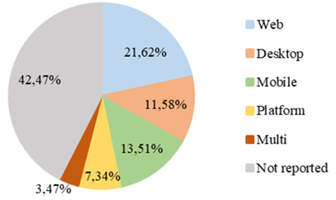
Publications: specific statistics 1/3
User interface of evaluated educational games

Slide 15
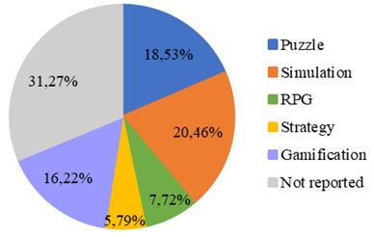
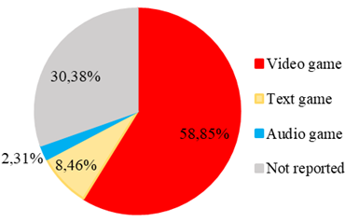
Genres and types educational digital games
Publications: specific statistics 2/2

Slide 16
Publications: specific statistics 3/3
273 non-relevant items
Considered and analyzed 256 scientific publications:
143 (56%) presented results from a quantitative analysis
105 (41%) reported findings from a qualitative analysis,
42 (16%) presented both qualitative and quantitative findings.
124 (48%) focused on short-term studies (lasting no longer than one week),
60 (23%) reported a longitudinal study.
Presented results about the goal of the game evaluation:
145 (57%) publications on learning outcomes, 101 (39%) – on game learnability,
100 (39%) – on validating usability, 92 (36%) – on engagement,
63 (25%) – on motivation, and 37 (15%) – on game playability.

Slide 17
DISCUSSION 1/3
The survey results asserts that video games in STEM learning are a current topic in education
The study examined publications evaluating modern educational video games and other games and game platforms with didactic content from different genres, such as: RPGs, escape rooms, simulations, puzzle games, augmented/ virtual reality (AR/VR) games, strategy games, etc.
The survey findings show that educational video games are successfully applied in STEM education –
Gamification and game-based learning are particularly efficient in educating young people
Puzzles and simulation games are used in a STEM context:
Especially well-suited for presenting related knowledge.
Their features and game mechanics interpret science concepts and simulate natural phenomena

Slide 18
DISCUSSION 2/3
The gamification approach is typically applied to enhance comprehension of more complex notions
The presented studies analyzed and evaluated in detail the influence, impact and benefits on learners (students, pupils, learners) for:
Student interest, behavior and engagement
Increase of the success in STEM education and knowledge acquisition in various fields.
The research presented explores several factors
Usability, motivation, engagement, learnability, playability, and learning performance or outcomes
The integration of intelligent technologies (large language models) in a flipped classroom approach- usual practice in computer science education

Slide 19
DISCUSSION 3/3
The most explored topics in the area of video games for STEM education are:
Game-based learning,
Gamification
Virtual and augmented reality,
Artificial intelligence.
There are relatively few games for student assessment and personalized learning.
The most used game platforms are Scratch, Kahoot!, and Minecraft.
Educational video games (unlike entertainment games) are predominantly designed for Web and desktop computers, while the mobile and platform games take a relatively small share.

Slide 20
Limitations of the study
PRISMA bias toward well-cited networks; may miss some work
English-language publications are only useful for tracking enduring characteristics across time
Limited period – 2015-2025
Search in WoS and Scopus databases only
Analysis of the publication abstracts only
Additional efforts are required to assess the motivational and playability aspects of video game applications.
Most research in game evaluation focuses on short-term studies, which may lower the significance of the results.
There are not enough works on long-term evaluation.
Most abstracts do not provide comprehensive information about the specifics that the authors seek to explore.

Slide 21
CONCLUSIONS
The research results demonstrate the advancement of game-based learning and its integration into STEM education
Educational video games, gamification, and game-based learning enable students to achieve better results in their STEM studies by engaging in an intriguing technological environment and having fun
Educational video games have been steadily applied and have influenced STEM education over the last decade
Further research:
Full-text analysis of selected publications
Profiling the application of STEM video games across different educational stages (primary school, secondary education, and university environments)
Providing educators with recommendations for implementing appropriate learning and teaching scenarios using educational video games

Slide 22

Thank You for Your Attention!
If you have any questions, write to us:
valentina.terzieva@iict.bas.bg
bbontchev@fmi.uni-sofia.bg
yavor.dankov@fmi.uni-sofia.bg
aldi@fmi.uni-sofia.bg
The research is funded by project “MOdeling inTelligent Instruments for adaptIVe and personAlized educaTional STEM video gamEs” (MOTIVATE), contract No. КП-06-Н85/2 dated 05/12/2024 with the Bulgarian National Science Fund, and by the project UNITe BG16RFPR002-1.014-0004 funded by PRIDST.

